Slide 1

A PRESENTATION BY MASTER YOUR CARD
Understanding Contracts and Statements
Notes:
MasterCard isn’t trying to sell you a card – we want to share the value of card technology for your business.
Using card technology and electronic payments can help your start-up or small business compete with bigger operations in your hometown.
Cards offer convenience, control, and security for both your business and your customers.
We know that as you begin to accept cards, you may have some concerns about what your processor can and can’t do within your contract, MasterCard’s role in the rates you pay, and the nuances of your monthly statement.
That’s why we’ve created new standards and best practices for our company and everyone we do business with to ensure that all of our agreements are fair and transparent, which address the most common issues we’ve heard from our merchants.

Slide 2

Master Your Card is a community empowerment program from MasterCard that helps consumers, small businesses and governments learn how to get more from their money by using prepaid, debit and credit cards to access a financially empowering electronic payment network.

Slide 3
Understanding contracts and statements
Your business is accepting cards—you know their benefits,
but now you also know that there are some challenges
associated with them.
Today, we’ll discuss a few of the most common ones, and how
we can provide solutions that are simple and secure.

Slide 4
Problem
“I’m afraid I’m not going to know what I’m getting into before I sign a contract with a processor.”

Slide 5
Solution:
Small businesses should get a clear written summary of a contract before entering into an agreement.
Names, addresses and phone numbers of everyone who provides you a service.
Start and end dates, including anything about automatic renewal.
How and when you’ll get monthly statements.
The process and terms to cancel an agreement.
All the details and options for point-of-sale terminals and other hardware you
may lease, rent or buy.

Slide 6
Problem
“Processors can add fees at any time, but I am stuck in a long-term contract.”

Slide 7
Solution:
You have the right to terminate without penalty if new fees are added in your MasterCard agreement.
You aren’t trapped in a contract that has added expenses you didn’t agree to.
You can also terminate if fees are added without 30 days advanced notice.
At any time during your contract, you can request a rate review if you feel that your needs have changed. While processors might not change your rate after a review, you have the right to request one.

Slide 8
Problem
“I get a monthly statement that seems to change every month — especially the merchant discount rate.”

Slide 9
Solution:
Monthly statements provide clear and detailed explanations of how the merchant discount rate was calculated for that period.
You see the baseline costs clearly so that you can adapt any business processes to lower future costs (how and when you submit transactions, capturing more details for card-not-present transactions, etc.).
A clear understanding of the baseline costs helps you seek and negotiate for pricing models and processing partners that are the best fit and value.
Notes:
We’ll go through how to read your monthly statement shortly, but you can also talk with your processor to make sure you understand all your costs.

Slide 10

How to
read your statement
Notes:
Include explanation and discussion on:
Total volume
Third party transactions
Adjustments, charge backs, reversals
Total fees charged, including calculating the effective rate

Slide 11
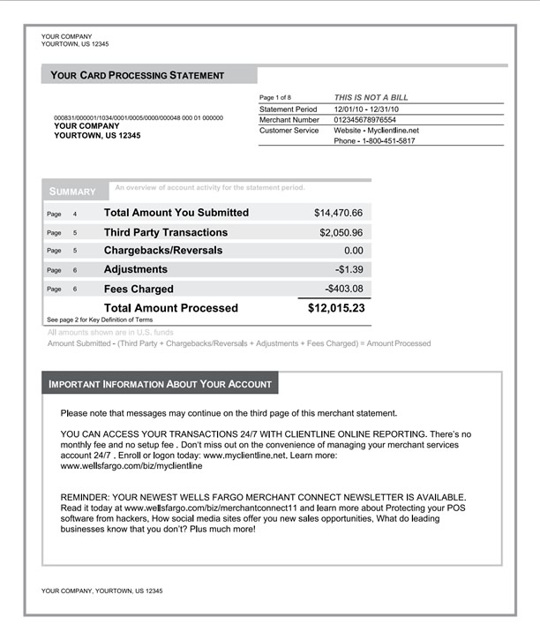
Your monthly statement
Notes:
Total Amount You Submitted – The total dollar amount of card transactions submitted and processed during the Statement Period.
Third-Party Transactions – These are transactions that are passed directly to third party service providers for processing and/or funding. Common third-parties include American Express and Discover.
Chargebacks/Reversals – Those transactions that are challenged or disputed by a cardholder or card-issuing bank. A Chargeback equals the transaction amount that is disputed by the cardholder or card-issuing bank. A Reversal is the amount that the merchant was initially charged, but has subsequently been credited back to the merchant.
Adjustments – The amounts added to or deducted from your account to resolve processing and billing discrepancies.
Fees Charged – Transaction-based and/or fixed amounts charged for specific card processing services.
Interchange Charges – These are the variable fees charged by card payment networks for processing transactions. Factors that affect Interchange Charges include card type, information contained in the transaction, and how/when the transaction was processed.
Total Amount Processed – The total amount processed is the dollar amount that a merchant service provider deposits into your bank account for the statement period, net of third party transactions, adjustments, fees, and chargebacks/reversals.
Merchant Number – The unique account number assigned to every merchant and merchant location. You'll find it at the top of your statement.

Slide 12
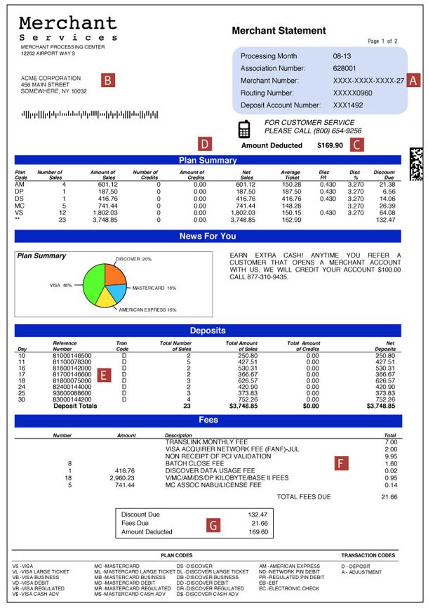
Monthly statement breakdown
Notes:
A: Merchant-specific account details
B: Merchant name and address
C: Total amount due, to be deducted on the 10th of the month
D: Summary of processing by card type
E: Breakdown of the transaction batch deposits by day
F: Breakdown of fees to be deducted from your account
G: Total of all discount and miscellaneous fees that will be deducted from your account

Slide 13

Get more resources:
www.masteryourcardUSA.org
• Download this presentation.
• Access fact sheets and helpful tips.
• Contact a Master Your Card representative.
Notes:
Accepting cards can raise some questions or concerns, and we want to make sure that our partners have all the information they need to be successful.
That’s why our standards and best practices work to ensure that all of our business relationships are fair and transparent, while helping you successfully accept cards and grow your business.
Learn more about the standards you should expect when doing business – and get other resources for your business – at masteryourcardusa.org.

Slide 14
Thank you

Slide 15
