Slide 1
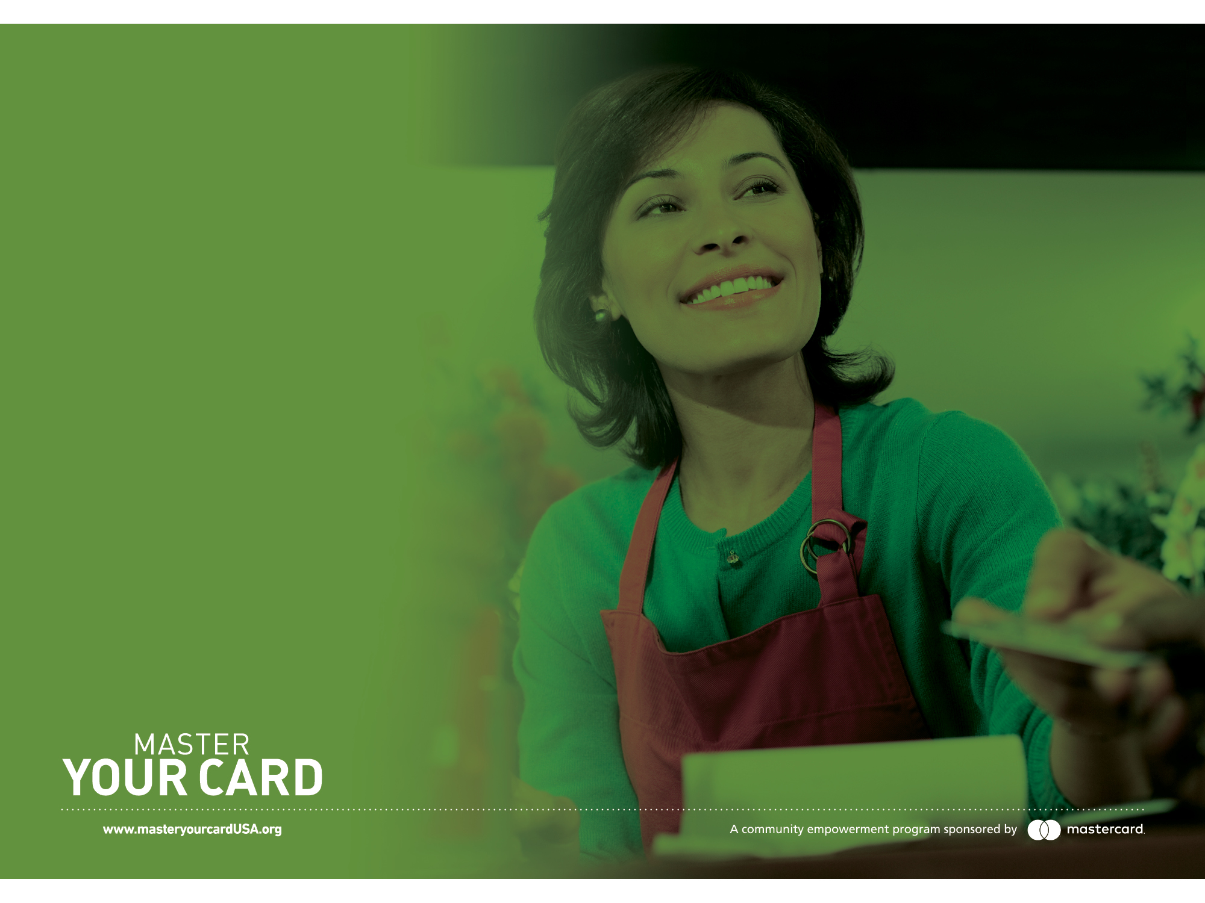
A PRESENTATION BY MASTER YOUR CARD
Consider cards
over cash
Notes:
MasterCard isn’t trying to sell you a card – we want to share the value of card technology for your business.
Using card technology and electronic payments can help your start-up or small business compete with bigger operations in your hometown.
Cards offer convenience, control, and security for both your business and your customers.

Slide 2
Master Your Card is a community empowerment program from Mastercard that helps consumers, small businesses and governments learn how to get more from their money by using prepaid, debit and credit cards to access a financially empowering electronic payment network.

Slide 3
What we’ll
cover today
The benefits of accepting cards and electronic payment technology

Slide 4
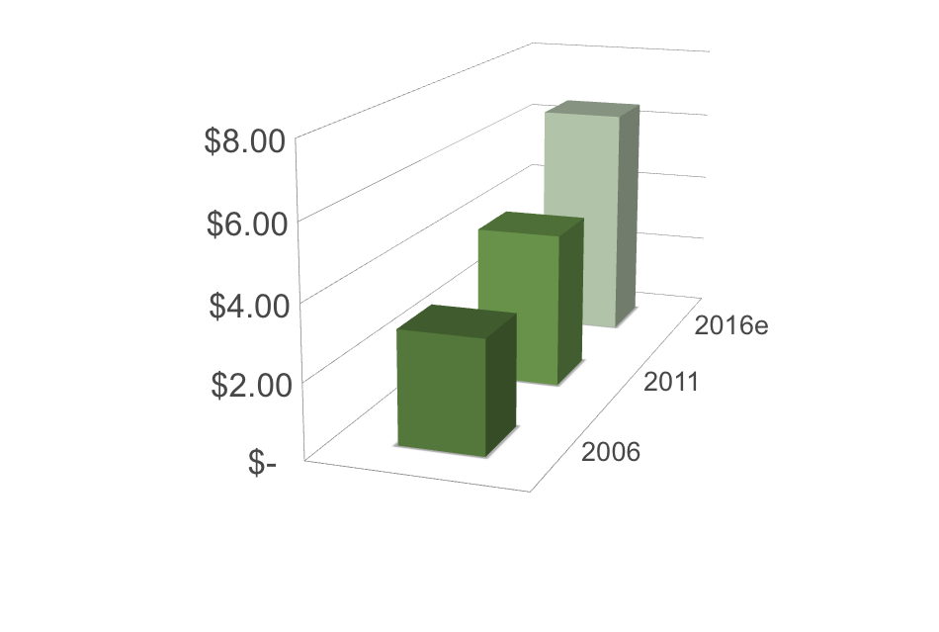
Card-based
payments
represent approximately
50%
of consumer
expenditures today
$ in Trillions
Card payments in the U.S.
Source: Nilson Report, 2012
Notes:
Your customers prefer to use their debit, prepaid and credit cards – card payments represent 50% of all consumer purchases in the U.S.
Cards are easier for them to use, rather than cash or checks.
Cards are also safer and cheaper for your customers, since they protect their money with built-in fraud and loss protection, and eliminate the need to carry large amounts of cash.
4

Slide 5
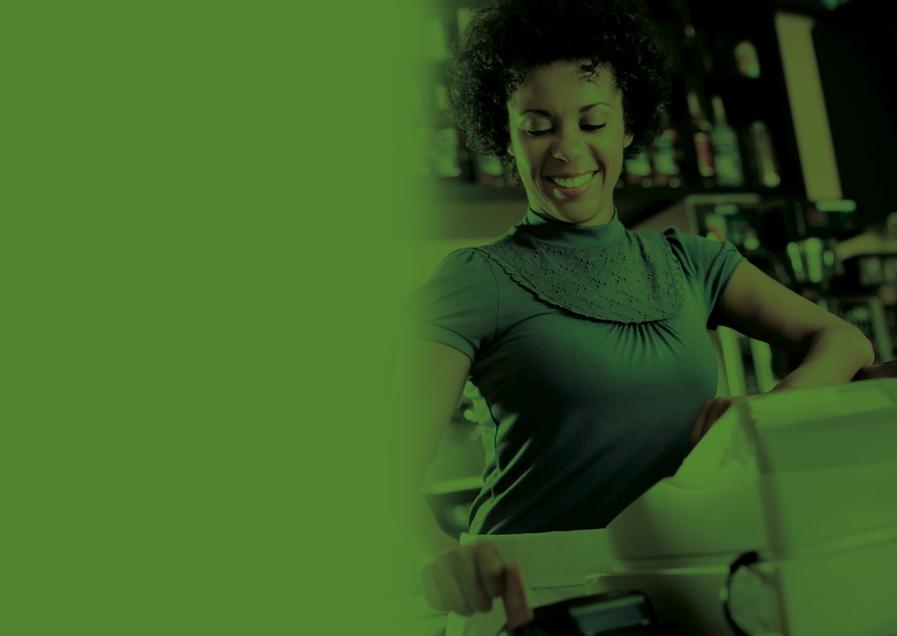
Benefits
of accepting cards for
your business
Notes:
We know that consumers not only want to use their cards at your business, but they’ll often spend more money when they do – studies show that consumers spend up to 16% more when using a payment card.
Yet 55% of the nation’s 27 million small businesses still don’t accept cards.
By accepting payment cards, your customers know that your business cares about their time, money, and security, ultimately leading to more and higher sales among your loyal customer base.
You’ll also have instant access to accurate account statements and balances, allowing for easier management of your finances.

Slide 6
Get customers
Electronic payments make the purchase or payment experience completely equivalent with any competitor—maximizing customer convenience and choice.
Customers have immediate access to their full purchasing power without any barriers to acting on their choice to do business with you.

Slide 7
Expand your
customer base
Compete with large businesses.
24/7/365 sales.
Higher revenues: an Intuit survey estimated that each business that does not accept cards misses out on ~$7,000 in sales annually—more than $100 billion in collective lost revenue.
Notes:
Accepting cards means that you can compete with large businesses, selling your goods and services in person, online and over the phone.
You can sell anywhere, anytime, which opens your business up to new customers who may not have previously shopped with you.

Slide 8
Grow your business
Customers spend more when they use cards.
Not taking cards means you’re missing out on sales.
Accepting cards tells customers that your business cares about their time,
money and security.

Slide 9
Accelerate growth
Automatic recurring payments are very valuable when providing a service.
Remote payments open up significant opportunities.
Electronic payments guarantee funds immediately so you can start work and
order inventory immediately and with confidence.

Slide 10
Manage
your money
State of the art accounting tools.
Money in your account faster.
More efficiency, less worry.
Notes:
Accepting electronic payments means that you also get access to state of the art accounting and management tools, like instant access to up-to-date account balances and statements, the ability to make online bill payments, and other tools to make your business more efficient.
These tools also include digital bookkeeping, setting up automatic recurring payments, and eliminating double entry.
When a customer uses a payment card, the funds typically reach your account in 24-72 hours, eliminating the wait for checks to clear.
These tools allow you to keep detailed and timely records and spend less energy, effort, and worry on processing checks and depositing cash.

Slide 11
Protect your business and customers
For your business:
No worrying about bounced checks.
Less risk of theft, counterfeit currency.
Better resources to protect your business.
For your customers:
Their cards protect them from loss, theft,
or fraudulent use.
Notes:
Your business
No worrying about the customer’s credit-worthiness or bounced checks.
You can also reduce the risk of cash register theft and counterfeit currency, as well as the risk associated with transporting large amounts of cash to your banks.
Accepting cards also gives access to resources to protect your business against data breaches, like best practices information and practical tips to protect yourself. Partners like your processor can help you make the transition to EMV technology and become PCI compliant.
Your customers
Their cards have their own protections for their funds in case of loss, theft, or fraudulent use.

Slide 12

Get more resources:
www.masteryourcardUSA.org
• Download this presentation.
• Access fact sheets and helpful tips.
• Contact a Master Your Card representative.
Notes:
Accepting cash is fine, but mastering card technology opens your business up to new opportunities for increased sales and growth
It also signals to your customers that you care about their time, security, and money
Taking advantage of all the resources and tools that cards offer means that you can more conveniently manage your business, while improving security.
Learn more about why cards are better than cash – and get other resources for your business – at masteryourcard.org

Slide 13
Thank you

Slide 14
