Slide 1
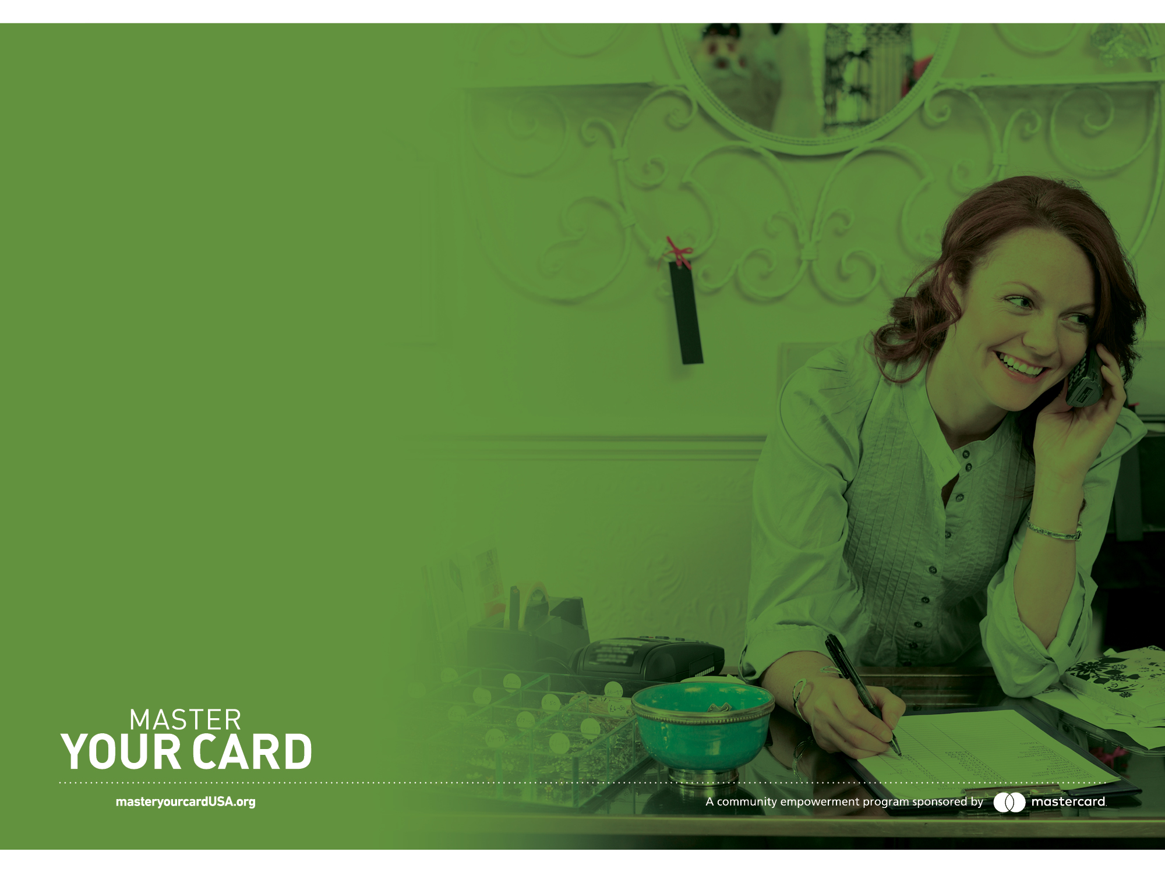
A PRESENTATION BY MASTER YOUR CARD
Making card acceptance
work for you
Notes:
Mastercard isn’t trying to sell you a card – we want to share the value of card technology for your business.
Using card technology and electronic payments can help your start-up or small business compete with bigger operations in your hometown.
Cards offer convenience, control, and security for both your business and your customers.
We know that as you begin to accept cards, you may have some concerns about data security, what your processor can and can’t do, and Mastercard’s role in the rates you pay.
That’s why we’ve created new standards and best practices for our company and everyone we do business with to ensure that all of our agreements are fair and transparent, which address the most common issues we’ve heard from our merchants.

Slide 2
Master Your Card is a community empowerment program from Mastercard that helps consumers, small businesses and governments learn how to get more from their money by using prepaid, debit and credit cards to access a financially empowering electronic payment network.

Slide 3
Making card acceptance work for you
Your business is accepting cards—you know their benefits,
but now you also know that there are some challenges
associated with them.
Today, we’ll discuss a few of the most common ones, and how
we can provide solutions that are simple and secure.

Slide 4
Problem
“Other stores have had high-profile data breaches when their customers used payment cards, and I don’t want my business or customers to be a target.”

Slide 5
Solution:
Helping small businesses adopt EMV technology and become PCI compliant.
Our partners work with businesses to provide information and other resources to help prepare your business for this year’s EMV transition.
PCI (Payment Card Industry) compliance is another critical step in protecting your data and securing your business, and our partners provide similar assistance to ensure that you’re doing everything you can to protect your operations.
Notes:
The EMV chip transition and accompanying terminal technology is one critical way to protect your customers’ and business’ sensitive data.
PCI
PCI compliance standards are rules that were put into place in order to make sure that merchants are being smart and secure with how they’re accepting cards, and prevent breaches like you may have heard of in the news. You can be charged a penalty if you are found to be operating outside those standards.
For example, writing down credit card numbers in order to keep them on file is not allowed because it is not a secure way to store sensitive information.
While your processor likely charges a fee for PCI compliance, this usually takes the place of an annual fee. Your PCI fee is usually tied to the size of your business and should not be exorbitant. Read your contract carefully to make sure you aren’t being charged a PCI compliance fee and annual fee.

Slide 6
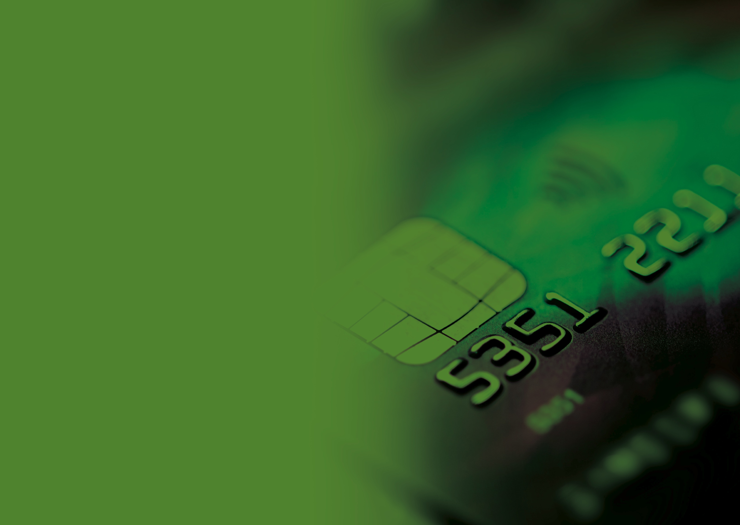
What you
need to know about EMV

Slide 7
A secure and dynamic
way to process payments
EMV is the global standard for secure digital card payments—the rest of the world has already moved to chip. Financial institutions have already begun issuing chip-enabled credit, debit and prepaid cards to consumers and small businesses.

Slide 8
Security
and consumer confidence
Magnetic stripe cards are susceptible to fraud, and can be copied.
Chip transactions are more secure. Each transaction has a unique and dynamic value – making counterfeit next to impossible.
Your customers will know you are serious about the security of their payments and will feel confident doing business with you.
Protect yourself from being a target for fraud.

Slide 9
Is the chip
upgrade mandatory?
No, the change to chip is not a mandate.
You can be liable for fraudulent card transactions if you do not have an EMV terminal at this time.
Accepting the chip will ensure you can take payments from all cards, safely and securely, from all over the world.
Many customers will know what to do, but be prepared to help if they need it.

Slide 10
Problem
“Processors promise a certain fee and then you get the bill with higher fees and can’t understand why—everything is lumped in together.”

Slide 11
Solution:
Complete, clear, truthful and simple disclosure.
Processors must provide all the information up front and eliminate any shell games where one label is used in a contract and another one is used on a monthly statement.
Every rate, fee and service is defined from the outset, then honored and consistently calculated every month.
You can also call your processor at any time and ask to be walked through your statement to make sure you understand any fees or changes.
Notes:
Make sure you confirm with your processor that they will provide you with this level of disclosure while you are negotiating.

Slide 12
Problem
“Processors claim that Mastercard or Visa has raised the basic rate, but I can’t tell how much that was and if they are adding fees on top of that.”

Slide 13
Solution:
Any fee change coming from Mastercard will come with at least 30 days advance notice to processors and businesses alike.
Mastercard can’t surprise processors—and they can’t surprise business owners.
The basic fee increase must be shown as a separate line item from processor added fees.
You can see and reject new fees from processors.
You have time to negotiate or adapt before getting an unexpected cost increase from Mastercard in your monthly statement, and you can cancel your service with your processor within 30 days of the advance notice that they give you.

Slide 14

Get more resources:
masteryourcardUSA.org
• Download this presentation.
• Access fact sheets and helpful tips.
• Contact a Master Your Card representative.
Notes:
Accepting cards can raise some questions or concerns, and we want to make sure that our partners have all the information they need to be successful.
That’s why our standards and best practices work to ensure that all of our business relationships are fair and transparent, while helping you successfully accept cards and grow your business.
Learn more about the standards you should expect when doing business – and get other resources for your business – at masteryourcardusa.org.

Slide 15
Thank you

Slide 16
